Slide 1
Geovisual analysis of VGI for understanding people's behaviour in relation to multifaceted context
Natalia and Gennady Andrienko^{a,b}, Siming Chenª, Dirk Burghardt^{c}, Alexander Dunkel^{c}, Ross Purves^{d}
ª Fraunhofer Institute IAIS, Sankt Augustin, Germany
^{b} City University London, UK
^{c} TU Dresden, Germany
^{d} University Zurich, Switzerland

Slide 2
Volunteered Geographic Information (VGI)
geospatial content generated by non-professionals
includes georeferenced materials published through location-based social media platforms (LBSM), e.g., flickr, Twitter, …
By posting these materials, people often express
their reactions to the
current spatio-temporal
context, including
various events

Slide 3
A conceptual model of reactions to events in LBSM
Alexander Dunkel, Gennady Andrienko, Natalia Andrienko, Dirk Burghardt, Eva Hauthal, and Ross Purves
A conceptual framework for studying collective reactions to events in location-based social media
International Journal of
Geographical Information
Science, 2019
(open access)
Event-Reaction Hypercube
https://doi.org/10.1080/13658816.2018.1546390

Slide 4
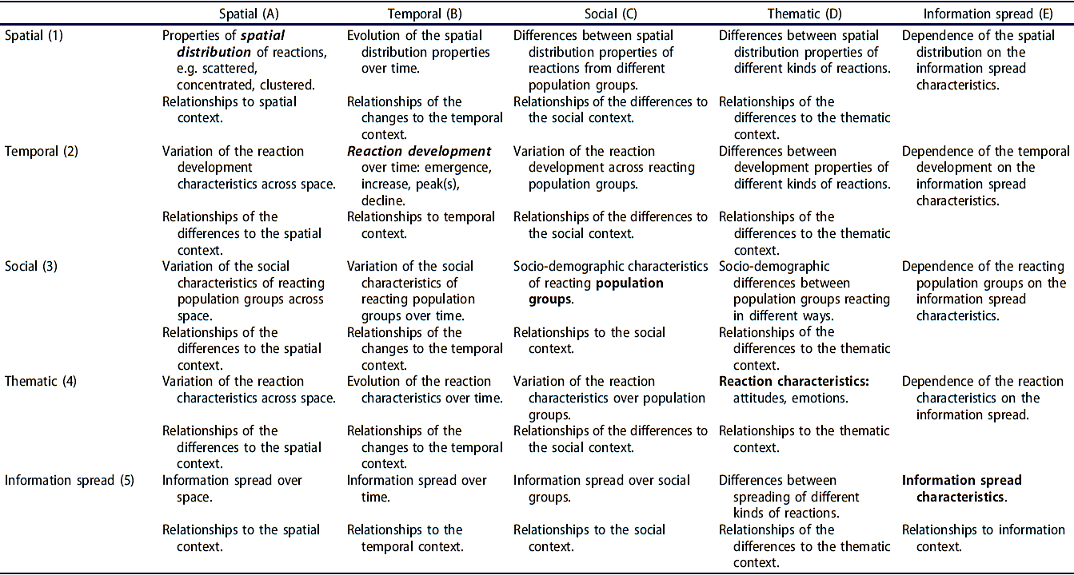
Analysis tasks

Slide 5
Analysis example (synthetic data)
VAST Challenge 2011
An epidemic outbreak in a city called Vastopolis
Data: geolocated tweets (include message, time, and coordinates)
  Some tweets mention disease symptoms: flu, chills, fever, …
Questions:
  When and where did the outbreak start?
  How did it develop?
  What is the disease transmission mechanism?
  What is the likely further development?

Slide 6
Using a database query, an analyst selected the tweets mentioning disease symptoms from the whole set of tweets. The word cloud display below shows the most frequent words and word combinations from the selected tweets. The font sizes are proportional to the frequencies.

Slide 7
Spatial distribution of the disease-related tweets

Slide 8
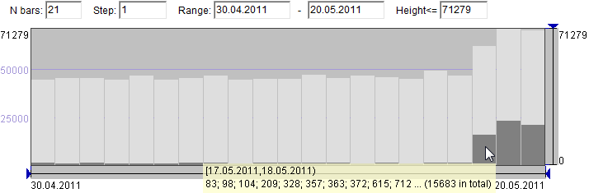
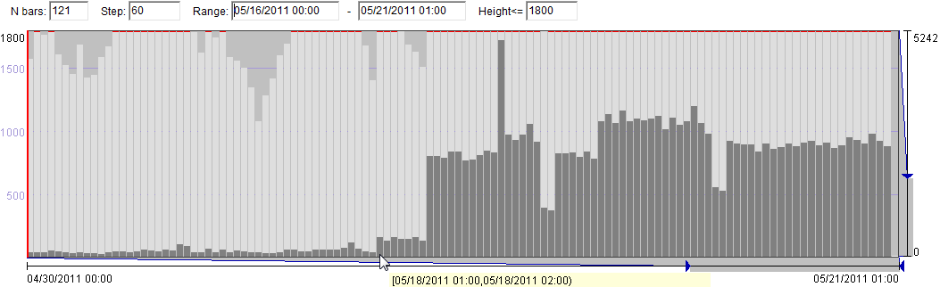
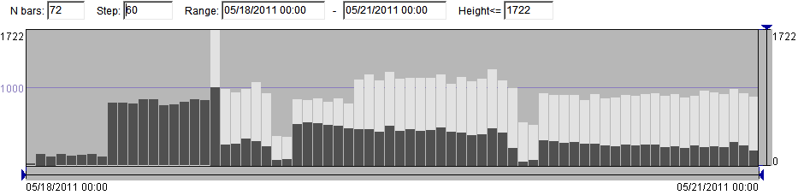
Temporal distribution of the disease-related tweets
Daily resolution
Hourly resolution, last 5 days
Outbreak start time
Each person’s first message mentioning disease symptoms

Slide 9
Spatio-temporal distribution of the disease-related tweets
May 20
May 19
May 18
May 18
May 19
May 20

Slide 10
Spatio-temporal distribution of the disease-related tweets
May 20
May 19
May 18
May 18
Hospitals
This cluster appeared on the second day of the outbreak
May 19
May 20

Slide 11
Thematic differences between spatial clusters

Slide 12
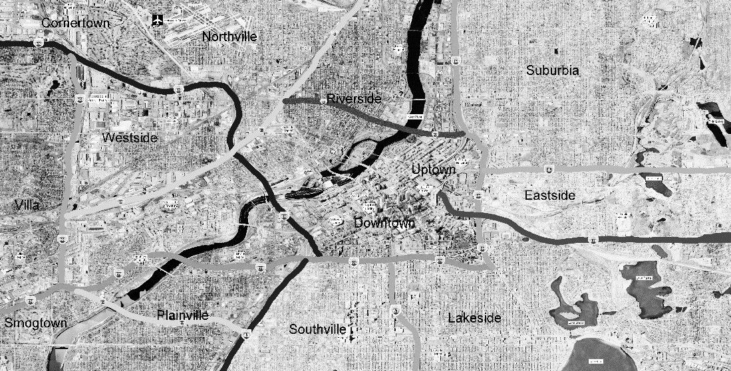
Context
Wind on May 18: from the west
River flow: to southwest
Common origin?
?

Slide 13
The probable cause of the outbreak

Slide 14
Trajectories of people who came to hospitals
Total: 4,884 people
4,628 of them visited
the central-eastern area
after the truck incident

Slide 15
Findings
Outbreak time: May 18-20, N people = 27 446, N messages = 59 755
Cluster center-east: May 18-20, N people = 16 479, N messages = 32 445; keywords: chills, fever, flu, headache, …
Cluster southwest: May 19-20, N people = 6 752, N messages = 9 719; keywords: stomach, ache, nausea, diarrhea, …
Hospitals: time = May 20, N people = 4 628, N messages = 4 628; keywords: chills, flu, fever, cough, …
Truck accident: time = May 17, N people = 149, N messages=149; keywords: truck, accident, terrible, burning, cargo, spilling, …
Task: communicate the findings to …
… health services, city administration, mass media, …

Slide 16
Story synthesis
Aggregate and summarize
  Simplification, controlling the level of detail
Embed details for aggregates
Arrange in a meaningful layout
Show information facets
  Heterogeneous facets (spatial, temporal, thematic, social) require complementary views
Annotate

Slide 17
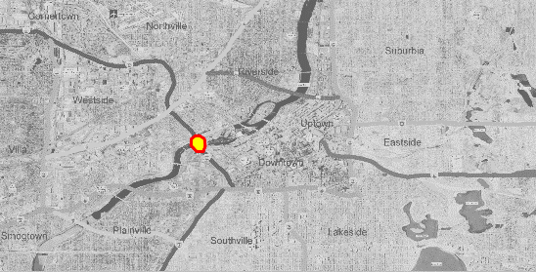
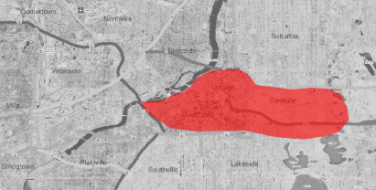
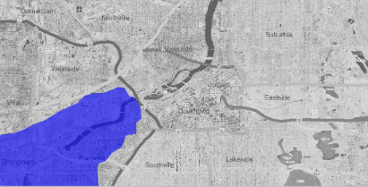
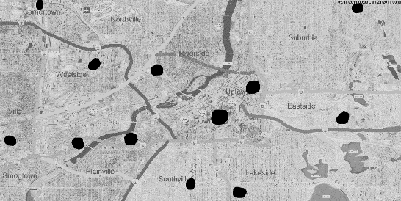
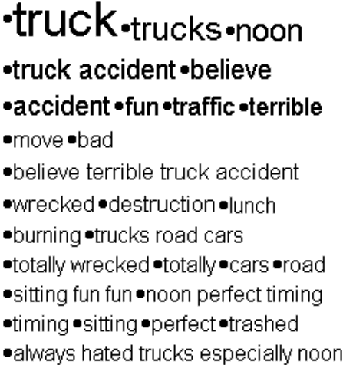
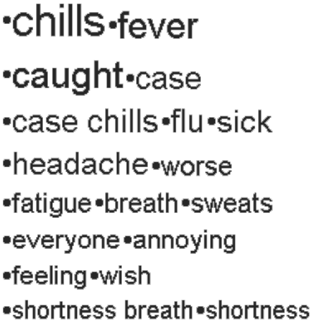
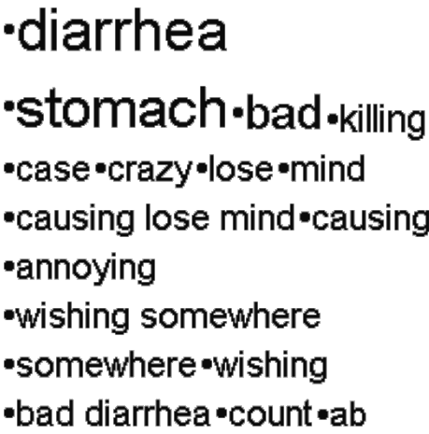
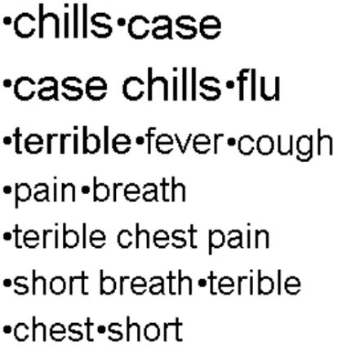
Story development over time temporal layout
May 17
May 18
May 19
May 20
Truck accident
Time: May 17
N people: 149
N messages: 149
Context: motorway, river bridge
Outbreak
Time: May 18-20
N people: 27,446
N messages: 59,755
Cluster center-east
Time: May 18-20
N people: 16,479
N messages: 32,445
Context: wind
Cluster southwest
Time: May 19-20
N people: 6,752
N messages: 9,719
Context: river flow
Coming to hospitals
Time: May 20
N people: 4,884
Context: being in central-eastern cluster area after the accident

Slide 18
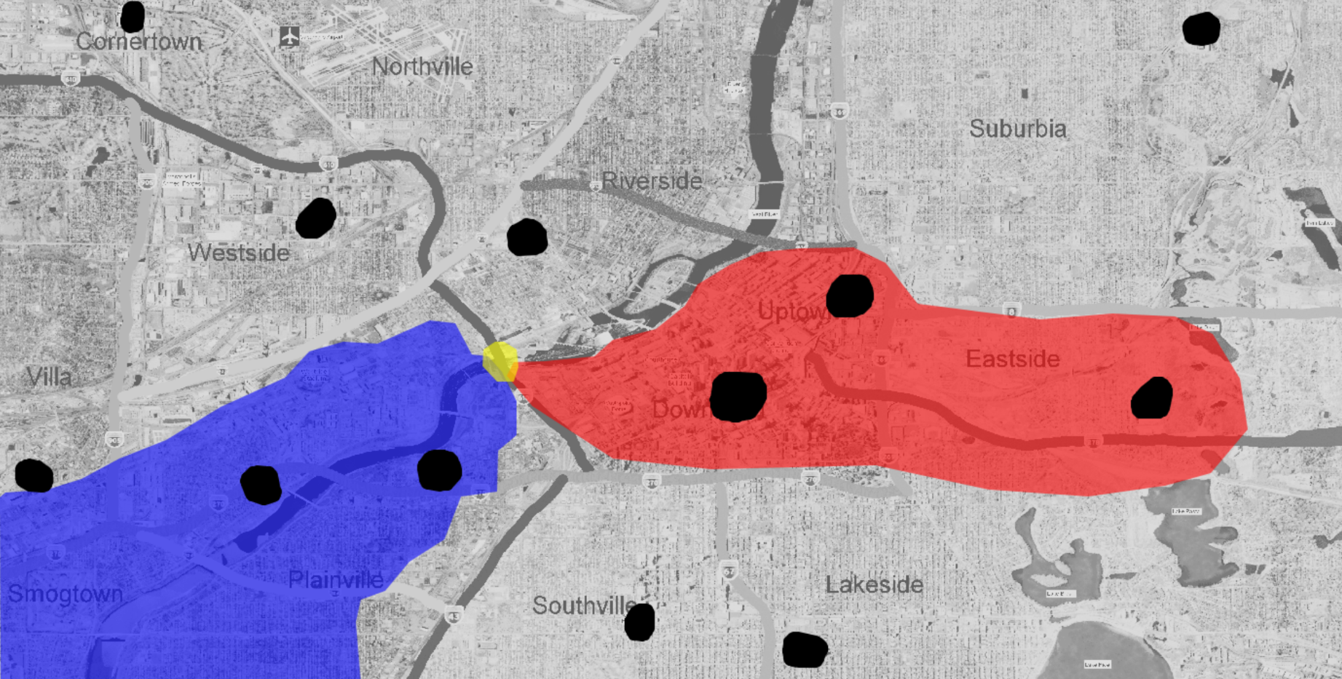
Relative positions in space spatial layout
Truck accident
Time: May 17
N people: 149
N messages: 149
Context: motorway, river bridge
Cluster center-east
Time: May 18-20
N people: 16,479
N messages: 32,445
Context: wind
Cluster southwest
Time: May 19-20
N people: 6,752
N messages: 9,719
Context: river flow
Clusters at hospitals
Time: May 20
N people: 4,884

Slide 19
Symptoms thematic layout

Slide 20
Workflow from analysis to communication
Visual analytics:
analytical reasoning supported by interactive visual representations
Story synthesis:
selection of information pieces, summarization, arrangement, annotation
Communication:
design of representations

Slide 21
Visual analysis of LBSM messages
Find and select relevant messages (text processing, queries)
Observe temporal variation of message amount
Find dense clusters in space and time, compare characteristics, relate to context
Summarize thematic contents; investigate changes over time, variation over space and over population
Reconstruct and investigate people’s
movements

Slide 22
Extensions required: analysis
Methods to characterize and study human behaviours
  Reaction contents, emotions, movements, activities, social links over time
Better approaches to incorporate context and study relationships of behaviours to context
Methods for comparative analyses regarding all facets
Definition of analysis tasks and characterization of outcomes
Geovisual analysis of VGI for understanding people's behaviour in relation to multifaceted context

Slide 23
Extensions required: communication
Representation for different types of analysis outcomes
  Commonalities and differences
  Relationships between facts, patterns, phenomena, events
  Impacts of context
Communication of background knowledge and reasoning
  Beyond textual annotations
Geovisual analysis of VGI for understanding people's behaviour in relation to multifaceted context

